Slide 1
Deep Learning-Based Multi-Variety Rice Grain Classification Using Pre-Trained Convolution Neural Networks
Transfer Learning │ Ensemble Voting │ Grad-CAM │ LIME
Md. Naim Molla, Md Muntasim Munif Fahim, Samiul Islam, Md. Binyamin, Md. Mahfuz Uddin, Md. A. Salam, Md Jahid Hasan Imran, Tonmoy Shil, Nura Rayhan & Md. Rezaul Karim
Data Science Research Lab, Department of Statistics, University of Rajshahi, Rajshahi-6205, Bangladesh
Notes:
Welcome. I will be presenting our research on rice grain classification using a deep learning ensemble with explainability analysis.

Slide 2
Motivation & Problem Statement
Manual Inspection is Unreliable
Research Gap
Traditional grain grading is slow, subjective, and error-prone — not scalable for modern agricultural operations.
Most rice classification systems rely on a single deep learning model without interpretability, limiting reliability and adoption in precision agriculture.
Single-Model Limitations
Most existing CNN systems rely on one architecture, which may miss complex grain morphology patterns captured by other model families.
Research Question
Can an ensemble of diverse pre-trained CNNs outperform any single model — and can Grad-CAM and LIME provide trustworthy, interpretable explanations for classification decisions?
Lack of Model Explainability
Deep learning models are treated as opaque black boxes, limiting trust and adoption in precision agriculture applications.
2 / 22
Notes:
Highlight the three pain points: manual grading limits, single-model brittleness, and the black-box nature of standard deep learning. The research question frames our dual contribution: ensemble performance and explainability.

Slide 3
Objectives
01
02
Grain Segmentation Pipeline
Multi-Architecture Transfer Learning
Design an Otsu-based preprocessing pipeline to isolate rice grains from the background, ensuring models focus exclusively on grain morphology.
Fine-tune six pre-trained CNNs — EfficientNetB0, MobileNetV2, VGG16, InceptionV3, Xception, and InceptionResNetV2 — using ImageNet weights.
03
04
Ensemble Voting Strategies
Explainability: Grad-CAM & LIME
Build and compare hard voting, soft voting, and validation-accuracy-weighted voting ensembles to improve robustness over individual models.
Apply Grad-CAM and LIME to each trained model to interpret which visual regions drive classification decisions and validate preprocessing effectiveness.
3 / 22
Notes:
Walk through all four objectives. Objectives 1–2 cover methodology; objective 3 is the core performance contribution; objective 4 is the explainability / XAI contribution.

Slide 4
Dataset Description
10
Rice Variety Classes
Class / Variety | Index
Aush | 0
BR-28 | 1
BR-29 | 2
Beroi | 3
Chinigura | 4
Class / Variety | Index
Ghee Bhog | 5
Katari Najir | 6
Katari Siddho | 7
Miniket | 8
Swarna | 9
75,000+
Total Images (Augmented)
70 / 15 / 15
Train / Val / Test Split
Stratified
Sampling Strategy
4 / 22
Notes:
Update the class names and counts with your actual DATA_DIR contents. The stratified 70/15/15 split preserves class proportions in every subset. The dataset is pre-augmented, so augmentation during training adds additional variation on top.

Slide 5
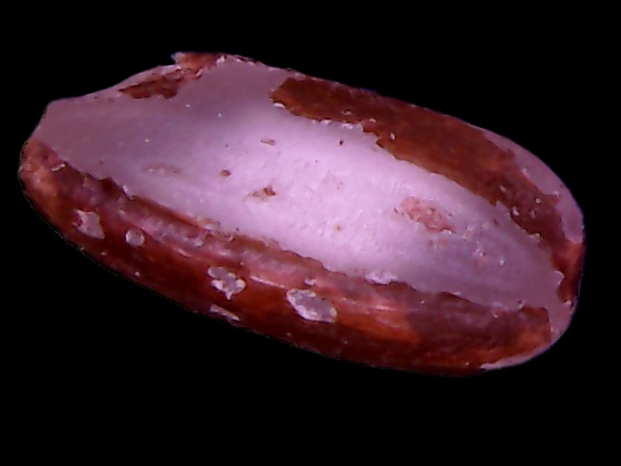
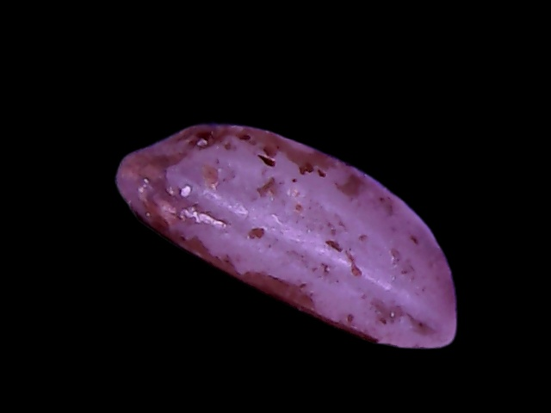
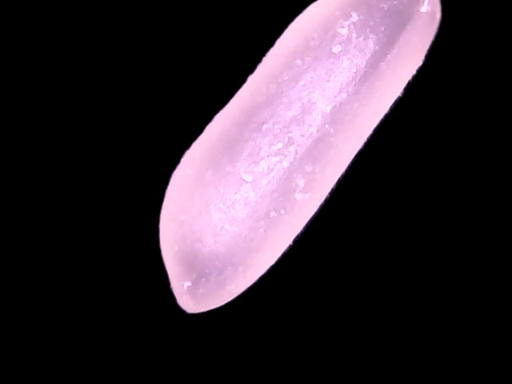
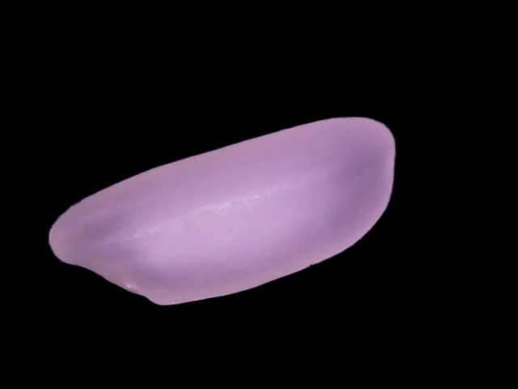
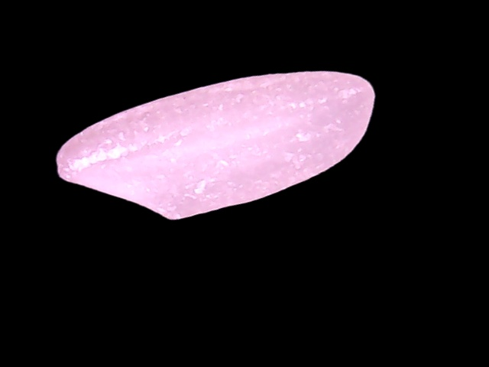
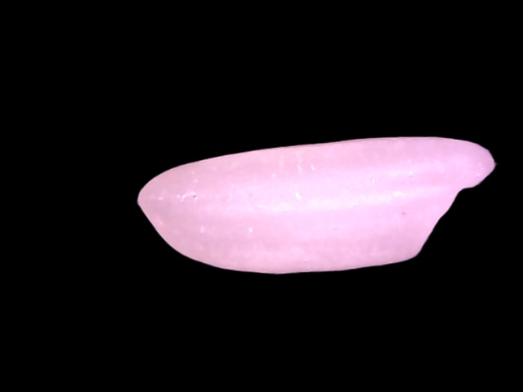
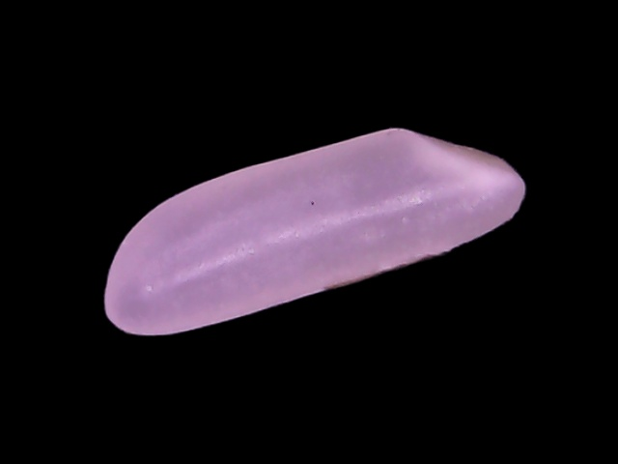
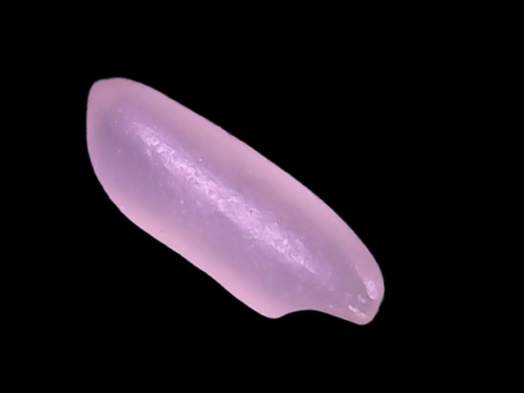
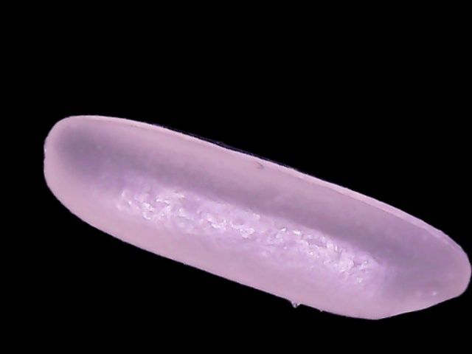
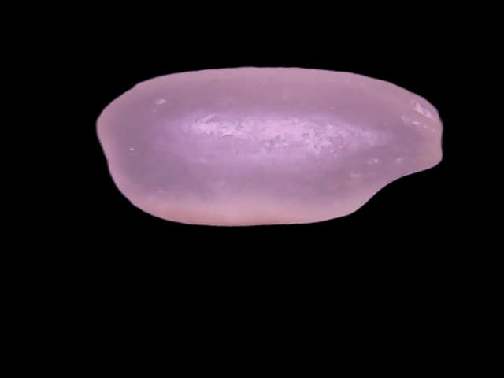
Dataset Sample
Aush
Beroi
BR-28
BR-29
Chinigura
Ghee Bhog
Katari Najir
Katari Siddho
Miniket
Swarna
4 / 22
Notes:
Update the class names and counts with your actual DATA_DIR contents. The stratified 70/15/15 split preserves class proportions in every subset. The dataset is pre-augmented, so augmentation during training adds additional variation on top.

Slide 6
Preprocessing Pipeline
1
2
3
4
5
6
Read Image
Grayscale
Otsu Binarization
Morphological
Cleanup
Apply Mask
Resize & Normalize
Load raw image
from disk
Convert BGR
to grayscale
Adaptive threshold
to create mask
Close gaps, median
blur noise removal
Bitwise AND keeps
only grain pixels
Output: 224×224
RGB float tensor

Slide 7
Model Architectures Overview
Model | Library | Input | Normalisation | Design Focus
EfficientNetB0 | torchvision | 224×224 | Standard ImageNet | Compound scaling — efficient accuracy
MobileNetV2 | torchvision | 224×224 | Standard ImageNet | Inverted residuals — mobile/edge optimised
VGG16 | torchvision | 224×224 | Standard ImageNet | Deep sequential convolutions
InceptionV3 | torchvision | 299×299 | Inception (μ=0.5) | Multi-scale parallel branches
Xception | timm | 299×299 | Inception (μ=0.5) | Depthwise separable convolutions
InceptionResNetV2 | timm | 299×299 | Inception (μ=0.5) | Residual connections + inception modules
7 / 22
Notes:
The six models span a broad design space: lightweight (MobileNetV2, EfficientNetB0), mid-range (VGG16), and high-capacity Inception-family. This diversity is key to ensemble effectiveness — different architectures capture complementary features.

Slide 8
Custom Classifier Head Design
BatchNorm1d (in_features)
Normalise backbone features
Pre-trained
Backbone
↓
Linear → 512
Project to hidden space
↓
ImageNet pre-trained weights
Convolutional feature extractor
Global average pooling
BatchNorm stats FROZEN
Gradients still flow through
ReLU
Non-linear activation
↓
Dropout (p = 0.4)
Regularisation
↓
Linear 512 → 256
Second projection
↓
ReLU
Non-linear activation
↓
Dropout (p = 0.3)
Regularisation
↓
Linear 256 → K classes
Output logits (K = num classes)
8 / 22
Notes:
The custom head is identical for all 6 models (except VGG16, which omits the first BN1d since it doesn't have BN in its backbone). Freezing backbone BatchNorm layers during training preserves the learned ImageNet statistics and prevents them from shifting on our smaller rice dataset.

Slide 9
Training Strategy
Adam Optimizer
LR Scheduler
Early Stopping
Learning rate: 1e-4
Weight decay: 1e-4
Gradient clipping: norm ≤ 1.0
Mirrors Keras clipnorm=1.0
ReduceLROnPlateau
Monitor: val accuracy
Factor: 0.5 (halves LR)
Patience: 5 | min_lr: 1e-7
Patience: 12 epochs
Best checkpoint saved
Weights restored on stop
Up to 20 epochs max
Training Configuration
BatchNorm Freezing Strategy
Epochs: 20 (max) | Batch size: 32 | Workers: 4
Mixed-precision AMP (FP16) on GPU — faster + less memory
Loss: CrossEntropyLoss | InceptionV3: main + 0.4 × aux loss
Per-model normalisation applied in DataLoader transforms
All backbone BN2d layers: set to eval() + freeze parameters
Custom head BN1d layers: kept trainable (no pretrained stats)
Rationale: preserves ImageNet-trained running mean/var
Prevents distribution shift on smaller rice dataset
9 / 22
Notes:
The BN freezing strategy is subtle but important. Without it, the running statistics of the backbone get corrupted by the rice data distribution, which reduces accuracy. Gradient clipping stabilises training, especially for larger models like InceptionResNetV2.

Slide 10
Ensemble Methods
Individual CNN Models
01
Hard Voting
Each model votes for its top-1 predicted class. Majority vote wins. Treats all models equally — simple and robust.
EfficientNetB0
MobileNetV2
02
Soft Voting
VGG16
Average the predicted probability vectors across all models. Softer decision boundary than hard voting, reduces over-confidence.
►
InceptionV3
03
Weighted Voting
Xception
Probability vectors are weighted by each model's validation accuracy. Higher-performing models contribute more to the final decision.
InceptionResNetV2
12 / 22
Notes:
The key insight of weighted voting is that it leverages the known performance differences between models. A model that achieved 98% validation accuracy contributes twice as much as one at 49%. This naturally down-weights weaker models without discarding them entirely.

Slide 11
Ensemble Performance Comparison
Method | Accuracy | Precision | Recall | F1-Score | AUC
EfficientNetB0 | 0.914 | 0.919 | 0.914 | 0.913 | 0.996
MobileNetV2 | 0.870 | 0.897 | 0.870 | 0.863 | 0.993
VGG16 | 0.925 | 0.930 | 0.925 | 0.924 | 0.997
InceptionV3 | 0.846 | 0.882 | 0.846 | 0.847 | 0.991
Xception | 0.930 | 0.940 | 0.930 | 0.931 | 0.998
InceptionResNetV2 | 0.877 | 0.904 | 0.877 | 0.877 | 0.996
Hard Voting | 0.954 | 0.956 | 0.954 | 0.954 | NaN
Soft Voting | 0.962 | 0.962 | 0.962 | 0.962 | 0.998
Weighted Voting | 0.961 | 0.962 | 0.961 | 0.961 | 0.998
13 / 22
Notes:
The key message here is the delta between best individual model and best ensemble. Even a 0.2-0.5% accuracy gain represents meaningful improvement at scale. Point out the precision/recall balance and note whether any class still struggles.

Slide 12
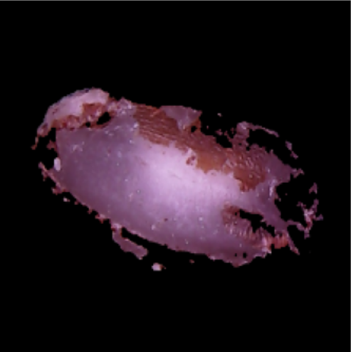
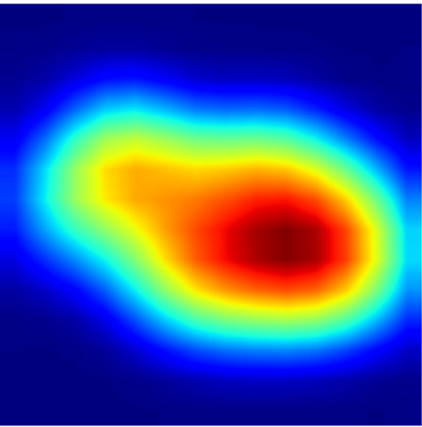
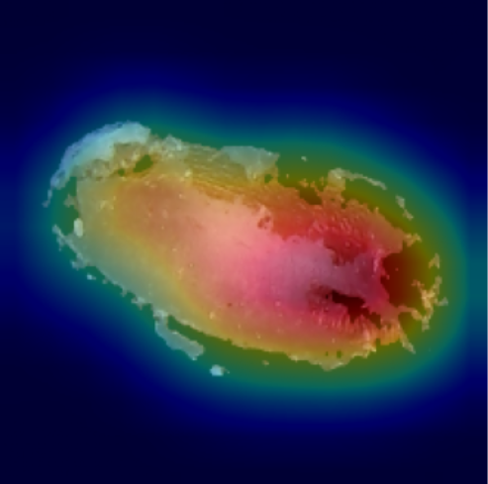
Explainability: Grad-CAM
How Grad-CAM Works
Target class gradient flows back through the network
Gradients at the final convolutional feature map are extracted
Global average-pooled → per-channel importance weights
Weighted sum of feature maps → coarse spatial heatmap
Heatmap resized and overlaid on input image
Red regions = most influential for the predicted class
Validates: do models attend to the grain, not the background?
15 / 22
Notes:
Key result to highlight: if Grad-CAM heat concentrates on the grain body rather than the black background, it validates that our preprocessing pipeline is working. All six models should show consistent attention on grain morphology and texture. Insert gradcam_all.png from your outputs/ folder.

Slide 13
Explainability: LIME
How LIME Works
Segments image into superpixels (coherent regions)
Generates perturbed samples by hiding random superpixels
Runs each perturbed sample through the trained model
Fits a weighted linear model to the perturbation responses
Top-5 positive superpixels highlighted with boundary marks
Model-agnostic: works with any black-box classifier
Complements Grad-CAM with a different explanation mechanism
16 / 22
Notes:
LIME and Grad-CAM together provide complementary explanations. Grad-CAM is gradient-based and native to the architecture; LIME is model-agnostic and perturbation-based. Agreement between them increases confidence in the explanations. Show one example per model if time allows.

Slide 14
Discussion
Why the Ensemble Worked
Limitations & Trade-offs
Model diversity: six architectures capture complementary spatial features
Weighted voting exploits known performance differences between models
Transfer learning reduced training data requirements significantly
Otsu segmentation validated by Grad-CAM — models focus on grain body
Per-model normalisation preserved each backbone’s learned feature statistics
Early stopping + ReduceLROnPlateau prevented overfitting across all models
Dataset is pre-augmented — does not represent fully wild, unconstrained grain images
Ensemble inference time scales linearly with the number of models (6× single)
Grad-CAM heatmap resolution is limited by the spatial size of the last conv layer
LIME explanations can vary with random seed and number of perturbation samples
All models trained on same dataset split — no cross-dataset validation reported
GPU memory requirements may be challenging for deployment on edge hardware
18 / 22
Notes:
Be upfront about limitations — reviewers and professors appreciate intellectual honesty. The key strength vs limitation trade-off to highlight is: ensemble performance gain vs inference time cost. This naturally leads into the Future Work slide on model distillation.

Slide 15
Conclusion
1
Preprocessing Validates Segmentation
2
Transfer Learning Achieves High Accuracy
Otsu-based grain segmentation effectively removes background noise. Grad-CAM confirms models focus on morphological grain features, not background artefacts.
All six pre-trained CNNs achieve strong classification accuracy on rice grain varieties, validating the transfer learning approach with the custom head design.
3
Weighted Voting Ensemble Performs Best
4
Dual Explainability Builds Trust
The weighted voting ensemble outperforms all individual models across Accuracy, Precision, Recall, and F1, demonstrating the value of combining diverse architectures.
Grad-CAM and LIME provide complementary, consistent explanations — making the system interpretable and trustworthy for agricultural AI deployment.
22
Notes:
Conclude by tying back to the research question from Slide 2. You have shown that (a) the ensemble outperforms individual models, and (b) Grad-CAM and LIME provide trustworthy, consistent explanations. These two findings directly answer the research question.

Slide 16
Future Work
01 Real-World Validation
02 Knowledge Distillation
Test on unconstrained, field-captured grain images with non-uniform backgrounds, variable lighting, and mixed grain samples to assess generalisation.
Compress the six-model ensemble into a single lightweight student model, reducing inference time while preserving the ensemble’s accuracy advantage.
03 Multi-Modal Feature Fusion
04 Edge Deployment
Incorporate hand-crafted morphological features (aspect ratio, eccentricity, solidity) alongside CNN features as complementary side inputs to the classifier.
Optimise the best single model (or distilled ensemble) for real-time inference on mobile/edge hardware for on-farm grain quality grading.
20 / 22
Notes:
If time is limited, prioritise directions 01 and 02. Real-world validation is the most scientifically pressing (does the system work outside controlled conditions?). Knowledge distillation is the most practically impactful (can we deploy it at scale?).

Slide 17
References
[1] Busi, R., Prasanna, V., Bhavana, S., Kishore, T., Santhi, V., & Sainath, Y. (2024). Rice Grains Detection, Classification, and Quality Prediction Using Deep Learning. International Journal for Research in Applied Science and Engineering Technology. https://doi.org/10.22214/ijraset.2024.59321.
[2] Setiawan, R., & Oumarou, H. (2024). Classification of Rice Grain Varieties Using Ensemble Learning and Image Analysis Techniques. Indonesian Journal of Data and Science. https://doi.org/10.56705/ijodas.v5i1.129.
[3] Koklu, M., Cınar, I., & Taşpınar, Y. (2021). Classification of rice varieties with deep learning methods. Comput. Electron. Agric., 187, 106285. https://doi.org/10.1016/j.compag.2021.106285.
[4] Razavi, M., Mavaddati, S., & Koohi, H. (2024). ResNet deep models and transfer learning technique for classification and quality detection of rice cultivars. Expert Syst. Appl., 247, 123276. https://doi.org/10.1016/j.eswa.2024.123276.
[5] Dar, R., Din, N., Bhat, M., Assad, A., Islam, Z., Gulzar, W., & Yaseen, A. (2022). Classification of Rice Grain Varieties Using Deep Convolutional Neural Network Architectures. SSRN Electronic Journal. https://doi.org/10.2139/ssrn.4129842.
[6] Islam, M., Himel, G., Moazzam, M., & Uddin, M. (2025). Artificial Intelligence-based Rice Variety Classification: A State-of-the-Art Review and Future Directions. Smart Agricultural Technology. https://doi.org/10.1016/j.atech.2025.100788.
21 / 22
Notes:
Update references with exact DOIs and publication details. If the conference requires a specific citation format (e.g. IEEE, APA), reformat accordingly.

Slide 18
Thank You
Any Questions?
naim.molla.stats@gmail.com
Dataset: data.mendeley.com/datasets/sfp9s96prh/1
Code: https://github.com/md-naim-molla/Rice-Grain-Classification
Data Science Research Lab, Department of Statistics, University of Rajshahi, Rajshahi-6205, Bangladesh
Notes:
Leave plenty of time for Q&A. Anticipate questions about: (1) why these 6 models specifically, (2) what is the inference latency of the ensemble, (3) how would the pipeline handle real-world noisy backgrounds, (4) have you compared against traditional hand-crafted feature methods?

